Slide 1


Slide 2
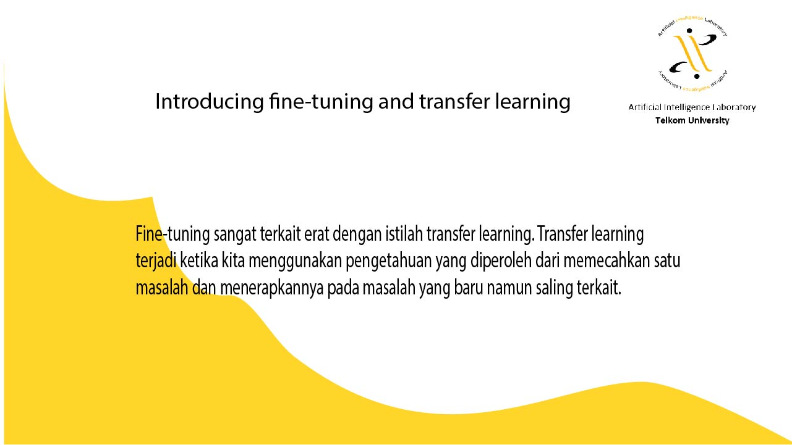

Slide 3
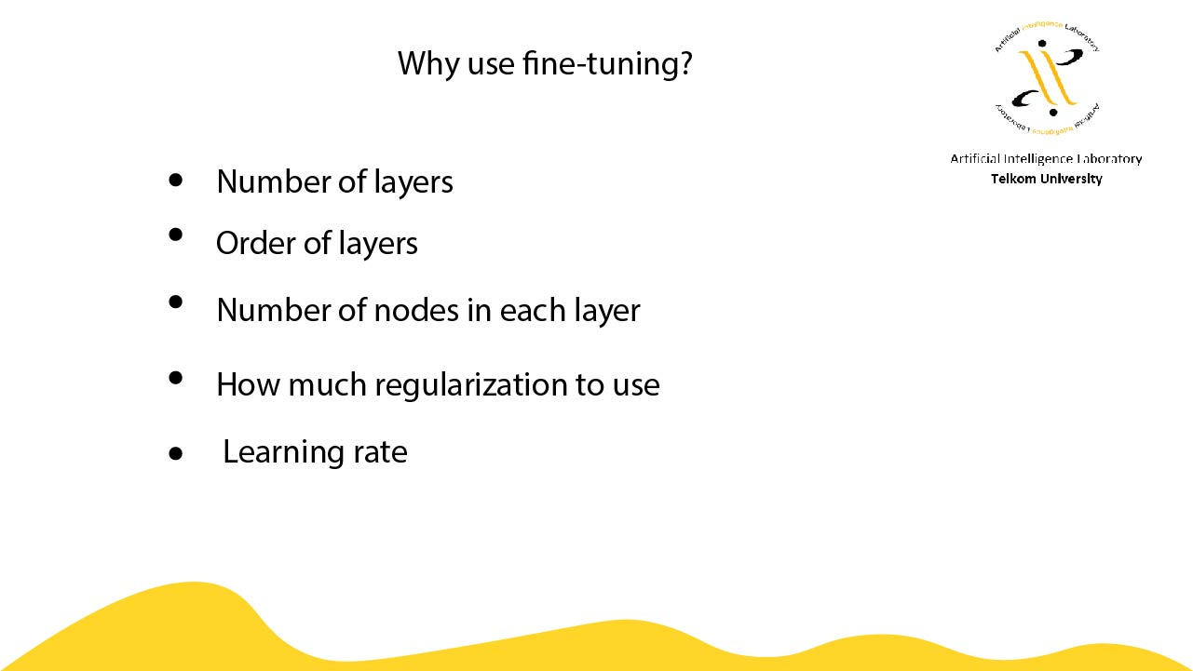

Slide 4
Normalisasi Dataset
Zero Center
Ubah range data menjadi [0, 1]
Zero Center dan range [-1, 1]

Slide 5
Loss Function
Mean Squared Error
Categorical Crossentropy
Binary Crossentropy

Slide 6
Optimizer
Adam
RMSProp
SGD (Stochastic Gradient Descent)

Slide 7
Batch
Full Batch
Mini Batch
SGD

Slide 8
Learning Rate
Rentang nilai LR yg baik
Decay LR

Slide 9
Activation
ReLu => max(0, x)
Sigmoid => [0, 1] -> diujung [binary]
Softmax => [0, 1] -> diujung [one hot matrix]
Tanh => [0, 1]
Linear => [-inf, inf]

